Slide 1





ABP v9.2 Highlights & Community News
@EngincanVeske
Engincan VESKE
EngincanV
Software Engineer at Volosoft
✍️
engincanveske.substack.com

Slide 2



ABP 9.2 Highlights
Added ApplicationName Property to Isolate Background Jobs & Background Workers
Docs Module: Added “Alternative Words” to Filter Items
Introducing the Bunny BLOB Storage Provider
Upgraded MongoDB.Driver to v3.1.0
Using Timezone Settings to Display DateTime
Identity Pro Module: Require Email Verification to Register
Switching Users During OAuth Login
Read the blog post
Notes:
https://abp.io/community/articles/abp-platform-jpq072nh

Slide 3
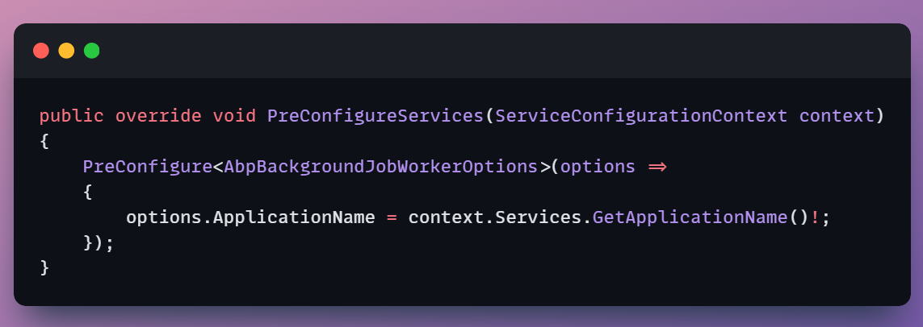
Added ApplicationName Property to Isolate Background Jobs & Background Workers
Notes:
When multiple applications share the same storage for ABP's Background Jobs Module, jobs from one application might be visible to another application. This can lead to the following issues:
Applications may attempt to process jobs that don't belong to them
These attempts fail with "Undefined background job for the job name" error
Failed jobs are marked as IsAbandoned = true
The original application can no longer process these abandoned jobs
To fix this, we added the ApplicationName property to the AbpBackgroundJobWorkerOptions class. This property allows you to specify the application name, which helps isolate jobs between different applications. (See the PR for more details.)

Slide 4
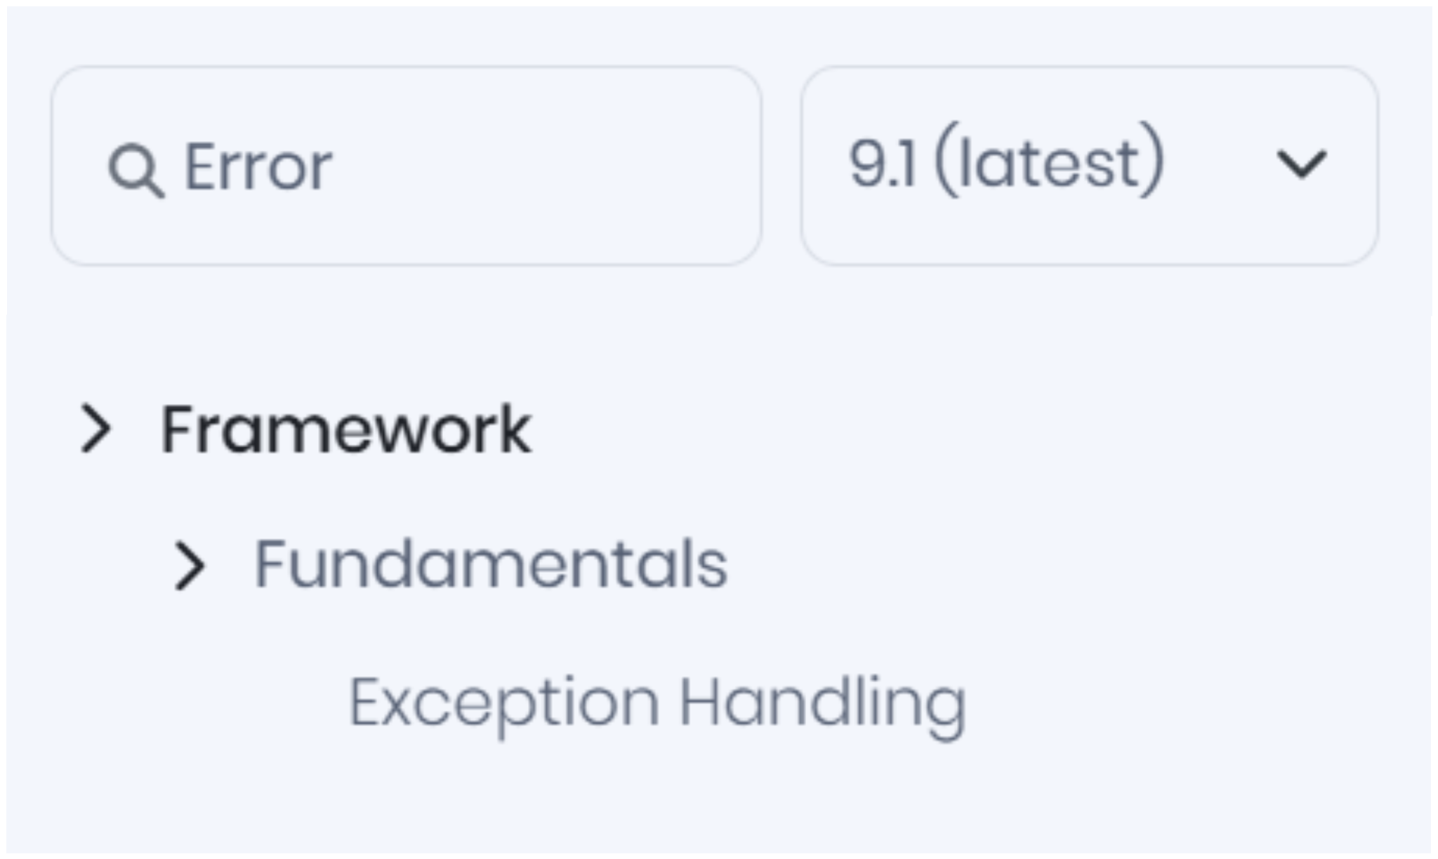
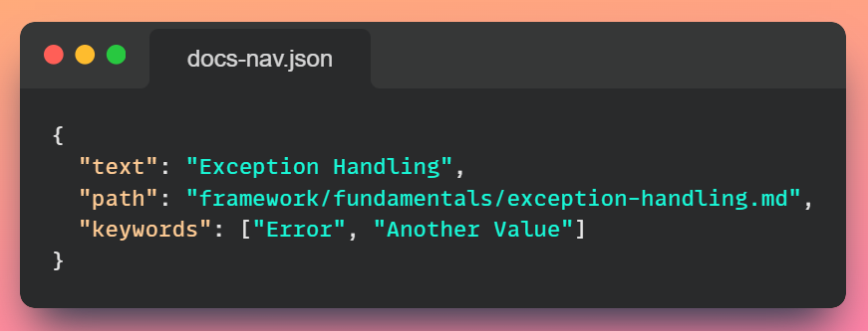
Docs Module: “Alternative Words”
for Filtering Items
Notes:
Docs Module: Added “Alternative Words” to Filter Items

Slide 5
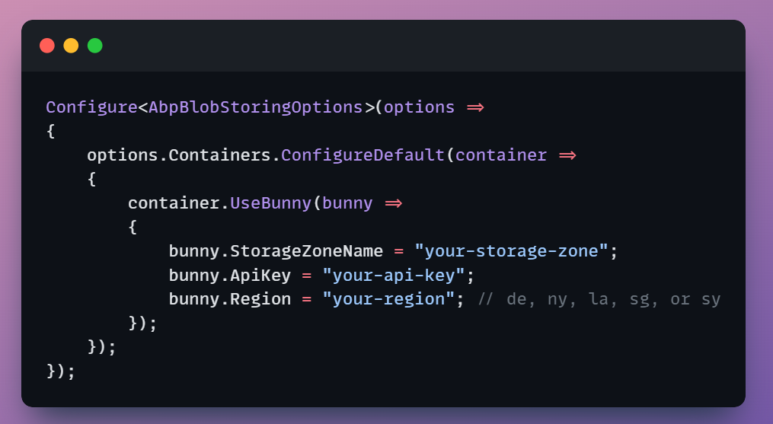
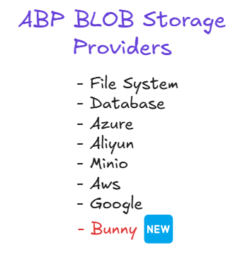
Bunny BLOB Storage Provider
Notes:
ABP v9.2 RC introduces a new BLOB storage provider for Bunny Storage, a global edge storage solution. This addition expands ABP's BLOB Storage options beyond the existing providers like Azure, AWS, and others.
The Bunny BLOB Storage Provider allows ABP applications to seamlessly integrate with Bunny's CDN-backed storage service, which offers high-performance content delivery through its global network.
To use this new provider, you'll need to:
Run abp add-package Volo.Abp.BlobStoring.Bunny command.

Slide 6
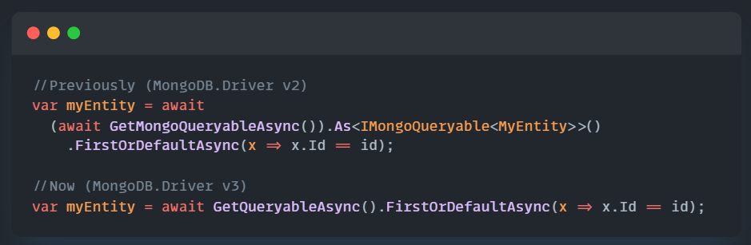

Upgraded MongoDB.Driver to v3.1.0
MongoDB v2 to v3
Notes:
ABP v9.2 RC includes an upgrade to MongoDB.Driver version 3.1.0. This significant version bump from previous releases brings several improvements and new features that benefit ABP applications using MongoDB as their database.

Slide 7
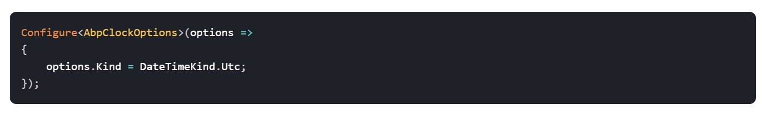
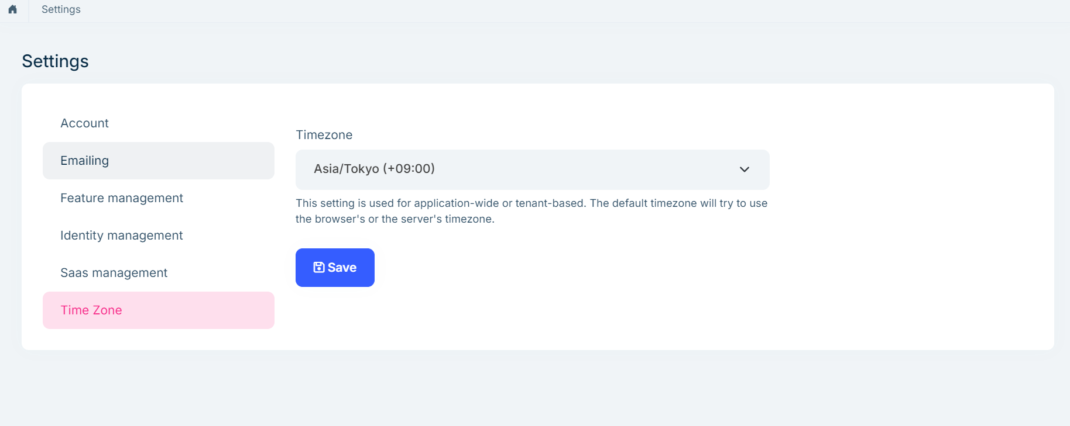
Using Timezone Settings to Display DateTime
Notes:
Previously, DateTime values were often shown in the server's timezone or in UTC, which could cause confusion for users in different timezones. With this new feature, ABP applications can now respect the configured timezone and automatically convert and display datetime values accordingly.
This feature addresses the common challenge of ensuring users see accurate time information, regardless of their geographical location.

Slide 8
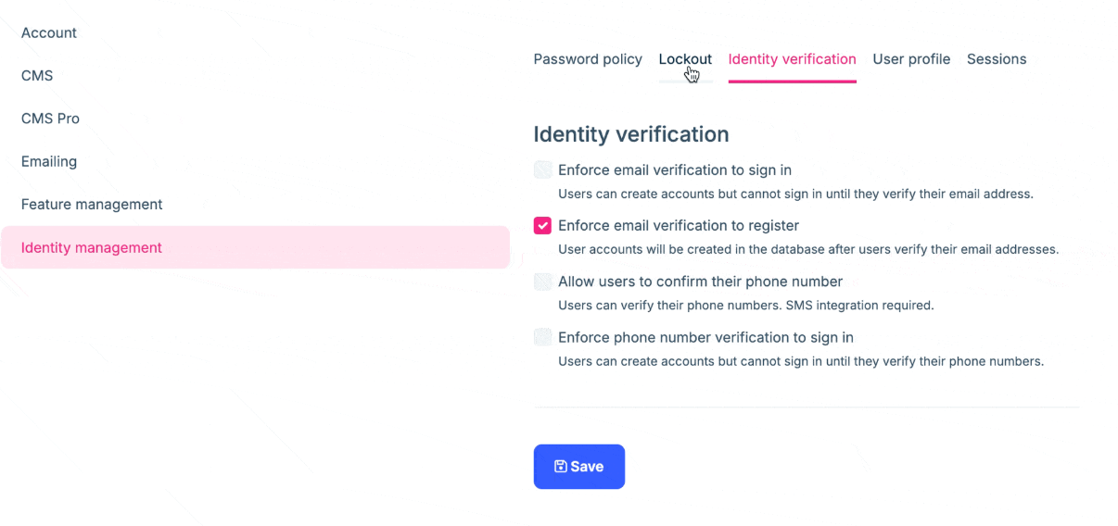
Identity Pro: Require Email Verification to Register
Notes:
ABP Identity Pro module has been enhanced with a new feature that allows administrators to require email verification during the registration process. This security improvement ensures that users must verify their email addresses before their registration is considered complete. Enabling this feature is especially important for applications that want to prevent spam registrations.
Administrators can enable or disable this feature through the Identity management -> Identity Verification (tab) settings page (by checking the Enforce email verification to register checkbox):

Slide 9
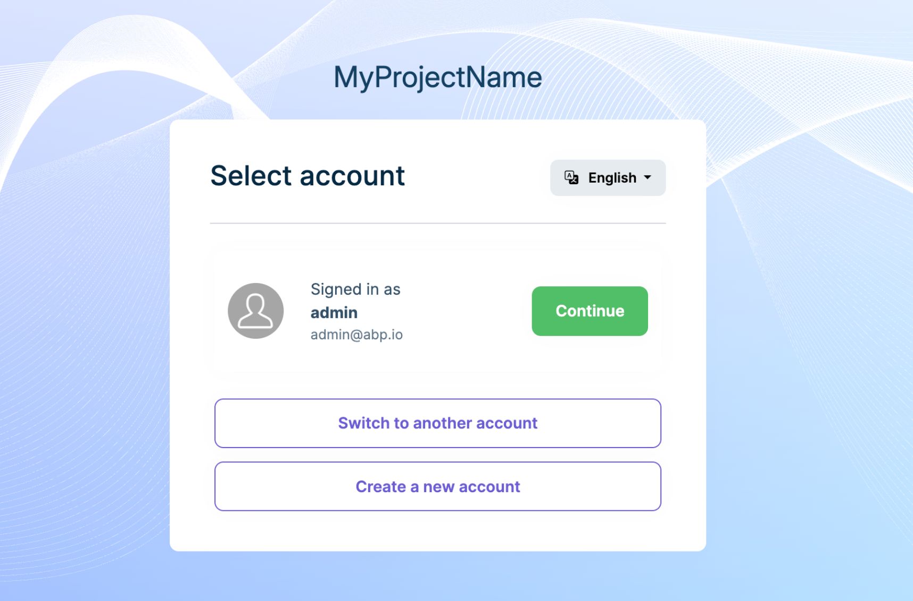
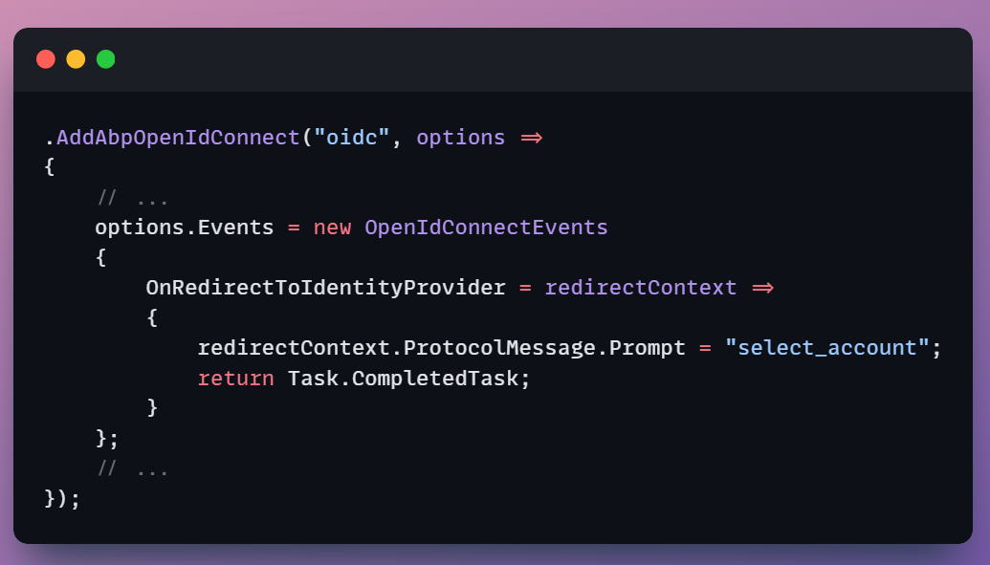
Switching Users During OAuth Login
Notes:
If you have an OAuth/Auth Server application using the ABP Account Pro module , you can pass the prompt=select_account parameter to
force the user to select an account.
For more information, please refer to the Switching users during OAuth login documentation.
—------------------------------------------------------------------------------------
https://abp.io/docs/9.2/modules/account-pro#switching-users-during-oauth-login

Slide 10

Migration Guides (v9.x to v9.2)
Open-Source (Framework)
Added ApplicationName Property (need to create a new migration & apply it to the database)
Upgraded MongoDB.Driver to v3.1.0
PRO Modules & Features
Identity Pro Module: Require Email Verification to Register (AccountAppService has been changed)
Read the migration guide

Slide 11
Community News
Community Posts (10+ articles & videos)
Blog Post: “We Had A Blast At BASTA! Frankfurt 2025”
Notes:
https://abp.io/community/articles/abp-platform-jpq072nh

Slide 12

Community Posts
(10+ articles & videos) https://abp.io/community/
Notes:
https://abp.io/community

Slide 13
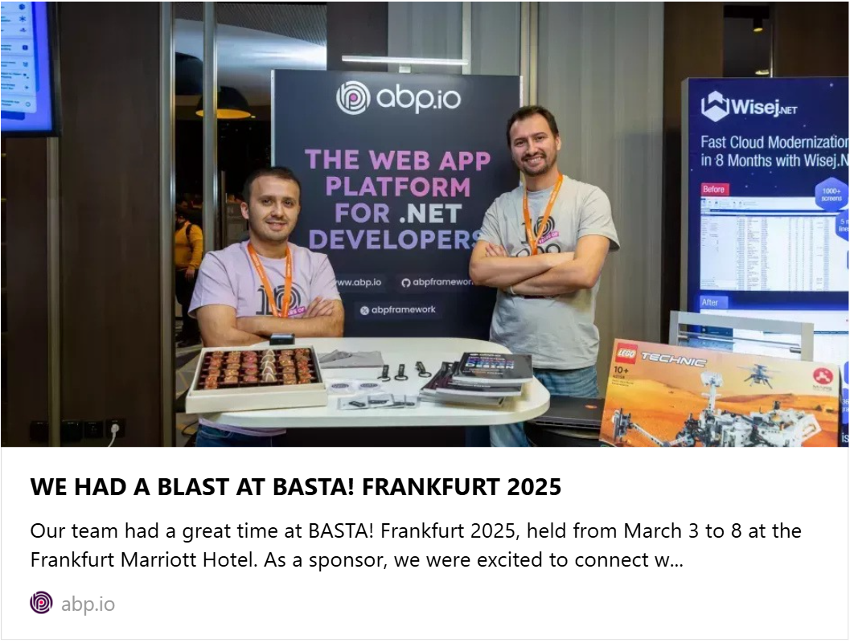

We Had A Blast At BASTA! Frankfurt 2025
Read the blog post
Notes:
https://abp.io/community/articles/we-had-a-blast-at-basta-frankfurt-2025-9cpcf17y

Slide 14
Thanks for listening!

